Slide 1
Progressive Web Apps

Slide 2
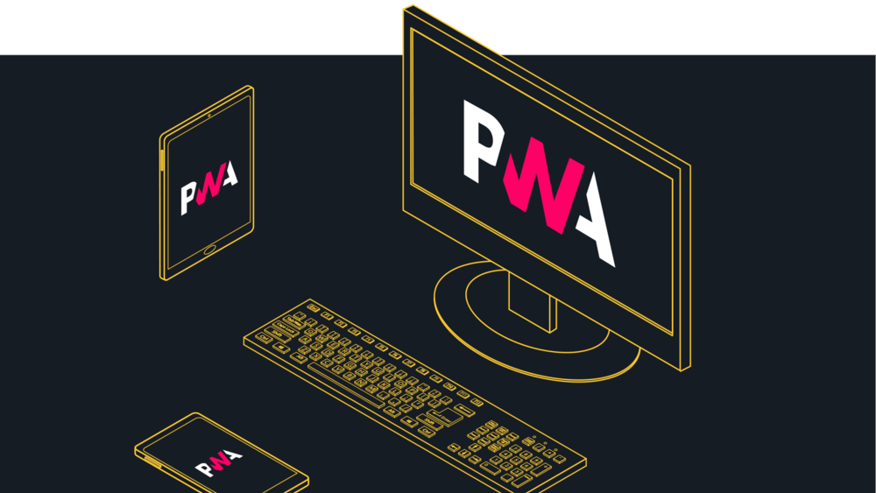

Slide 3

Rohan Patil
UX Engineer & FrontEnd Dev
@ Tata Consultancy Services
August 2019

Slide 4
PWA
A Progressive Web App uses modern web capabilities to deliver an app-like user experience.
They evolve from pages in browser tabs to immersive, top-level apps, maintaining the web's low friction at every moment.

Slide 5
Web vs Native

Slide 6
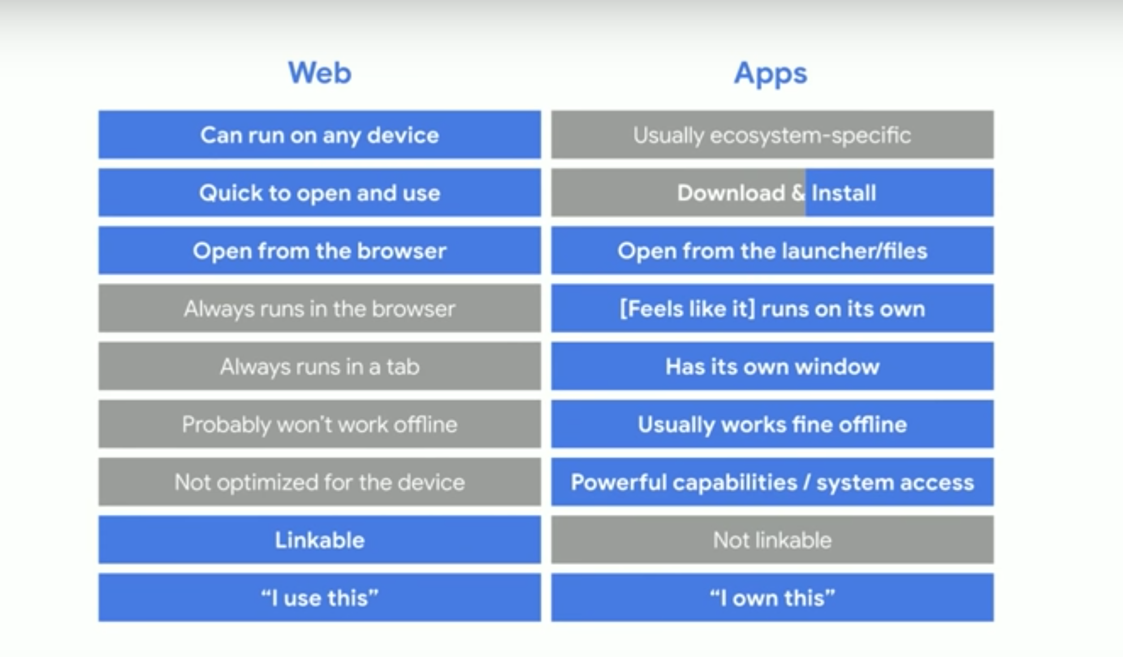

Slide 7
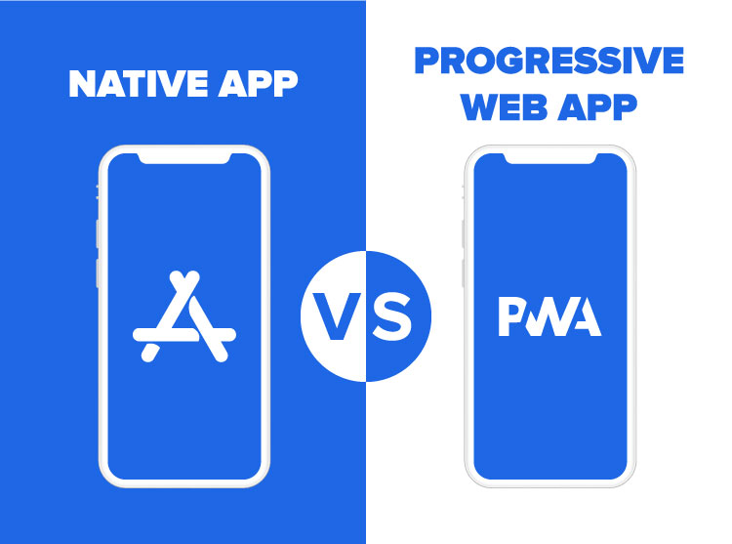

Slide 8
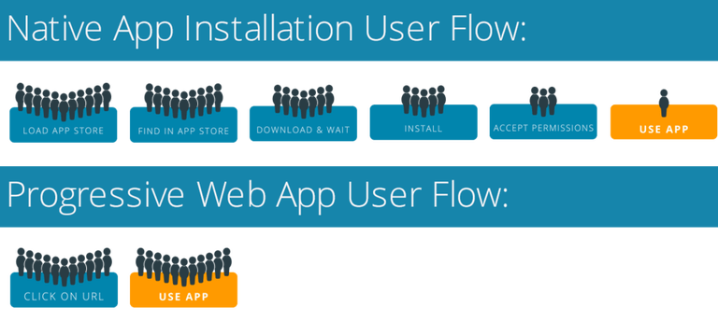
Installation

Slide 9
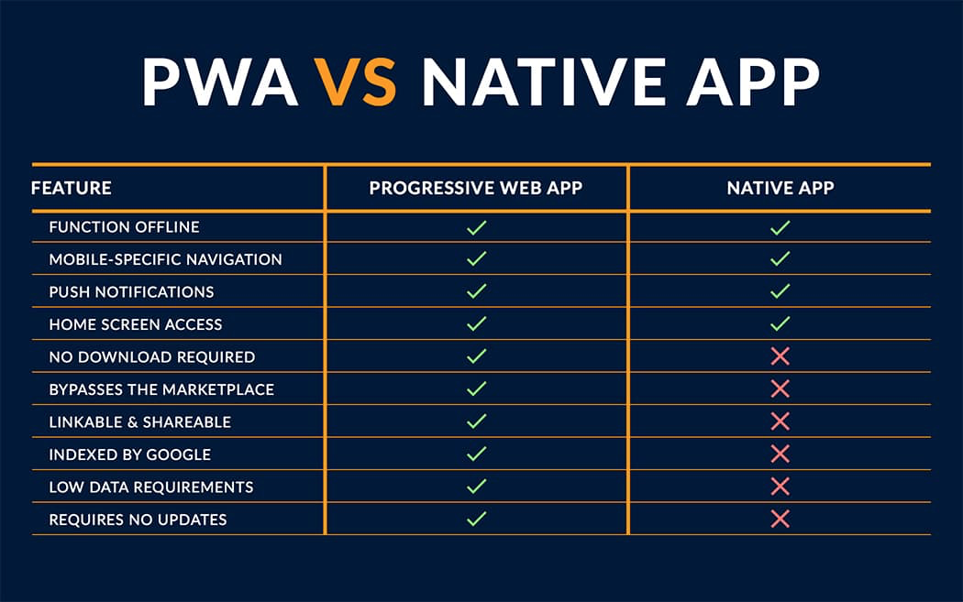

Slide 10
Best of both worlds

Slide 11
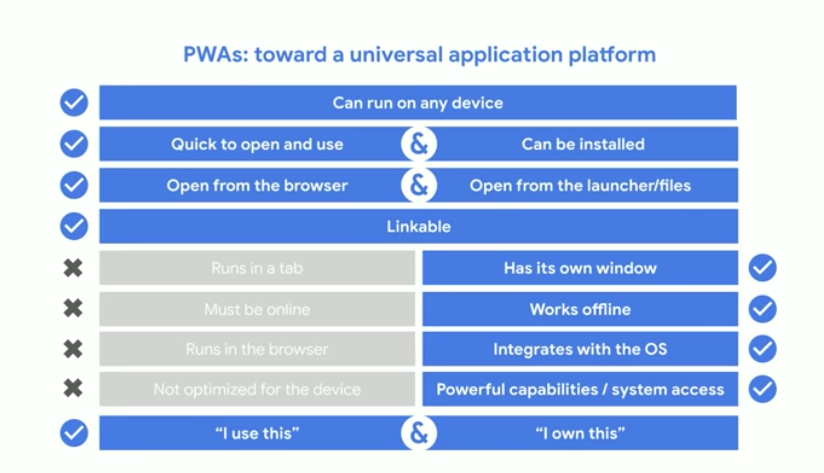

Slide 12
Popular PWAs

Slide 13
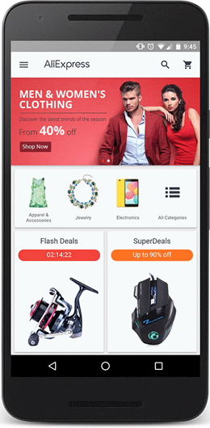
Ali Express
AliExpress witnessed incredible results after changing to Progressive Web Apps
104% increase in conversions for new users
2x more pages visited per session
74% increase in time spent per session

Slide 14
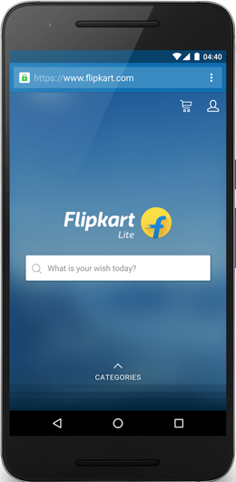
Flipkart
In 2015, Flipkart temporarily shut down its mobile website & embraced an app-only strategy.
They found it difficult to deliver an engaging web experience, especially because more than half of their users were browsing through flaky or 2G networks.
Flipkart Lite brought in some amazing results:
70% increase in conversions
40% higher re-engagement
3x more time spent on site
3x lower data usage

Slide 15
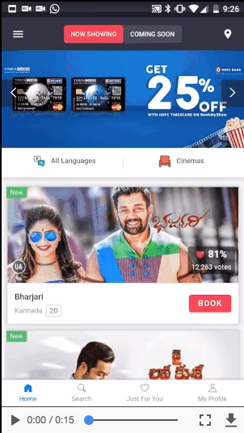
BookMyShow
In 2017, developed a Progressive Web App to replace their mobile site. The change broadened their customer base and increased conversions
Over 80% increase in conversions
54x smaller size than Android app
180x smaller size than iOS app
Checkout within 30 seconds

Slide 16
Few More PWAs
Twitter Lite
OLX
MakeMyTrip
Forbes
Housing.com

Slide 17
Core Concepts

Slide 18
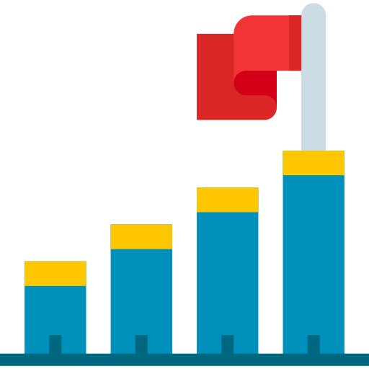
Progressive
Work for every user, regardless of browser choice, bcoz progressive enhancement is core choice.

Slide 19

Responsive
Fit to any form factor (Mobile, Tablet, Desktop)

Slide 20

Offline
Enhanced with Service Workers to work offline or on low quality networks

Slide 21

Secure
Served via HTTPS to prevent snooping and ensure content

Slide 22

Installable
Install without any App Store & have a place on home screen.

Slide 23

App Like
Use App Shell model to provide app-style navigations & interactions.

Slide 24

Re-engagable
Push Notification Support

Slide 25

Linkable
Identified as Application
Search Engines can find them
Easily share via URL and not require complex installation.

Slide 26
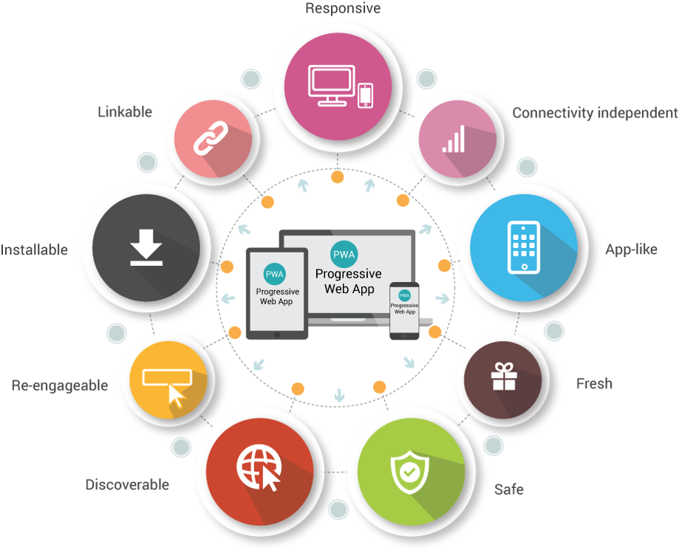

Slide 27
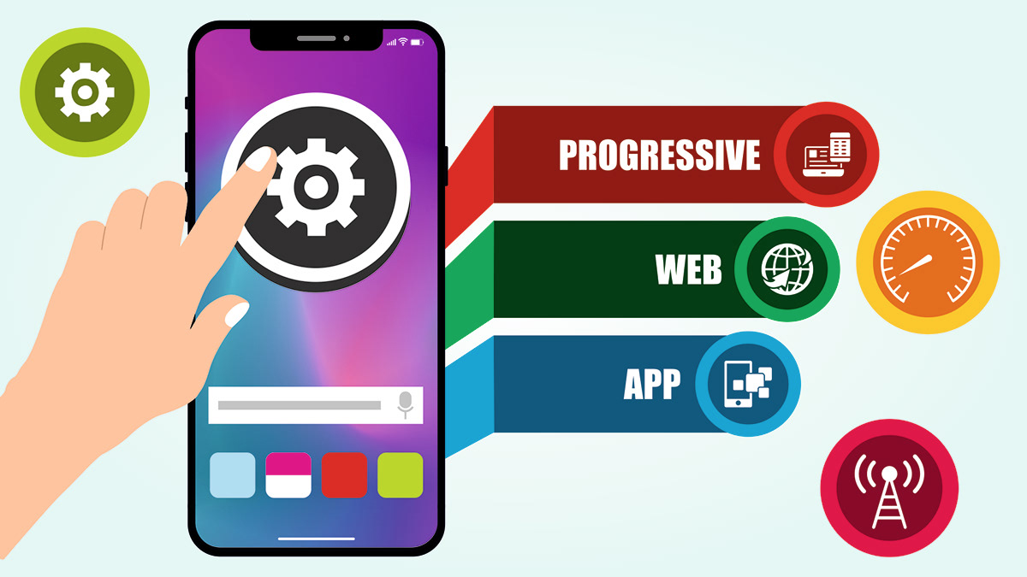
Fast
Reliable
Engaging

Slide 28
Technology Stack
Manifest.json
App Shell
Service Worker

Slide 29
Technology Stack
App Shell
Service Worker
App Manifest
Fast
Smooth User Experience
Offline
Cache
App Like Feel
Engaging

Slide 30

Manifest.json
Facilitates App Installs on Mobile Screen
Additional properties to generate app name, icons etc

Slide 31
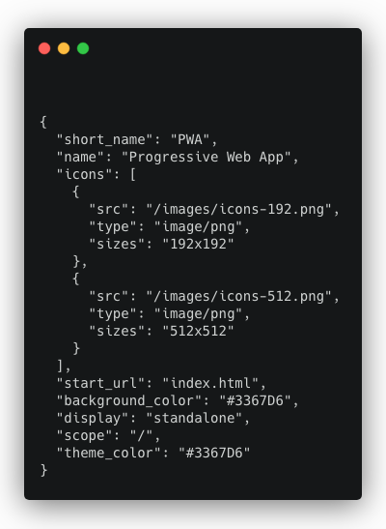
Manifest.json
https://app-manifest.firebaseapp.com/

Slide 32
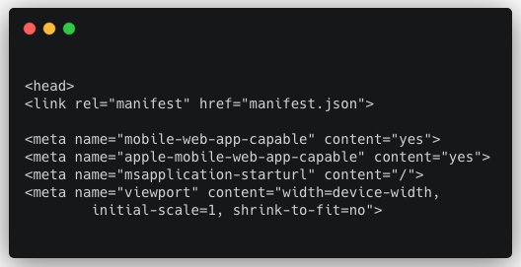
Manifest.json

Slide 33
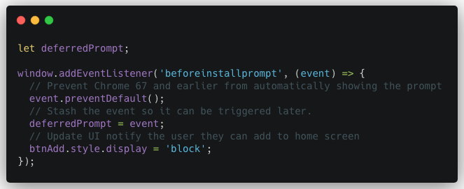
Installing the App : Listen and Install
Listen for the beforeinstallprompt event
Notify the user that your app can be installed
Show the prompt by calling prompt()

Slide 34
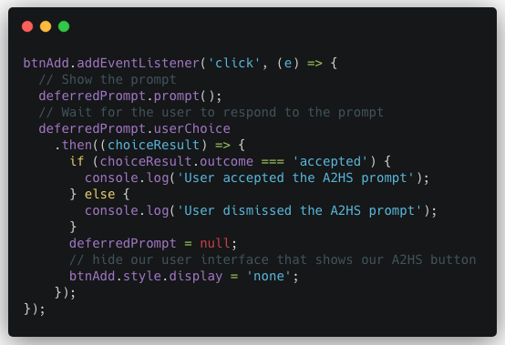
Installing the App : Show the Prompt

Slide 35
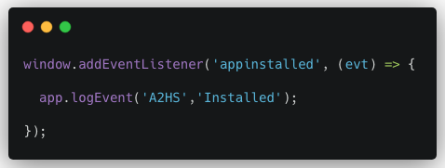
Installing the App: Confirming the Install

Slide 36
Demo

Slide 37
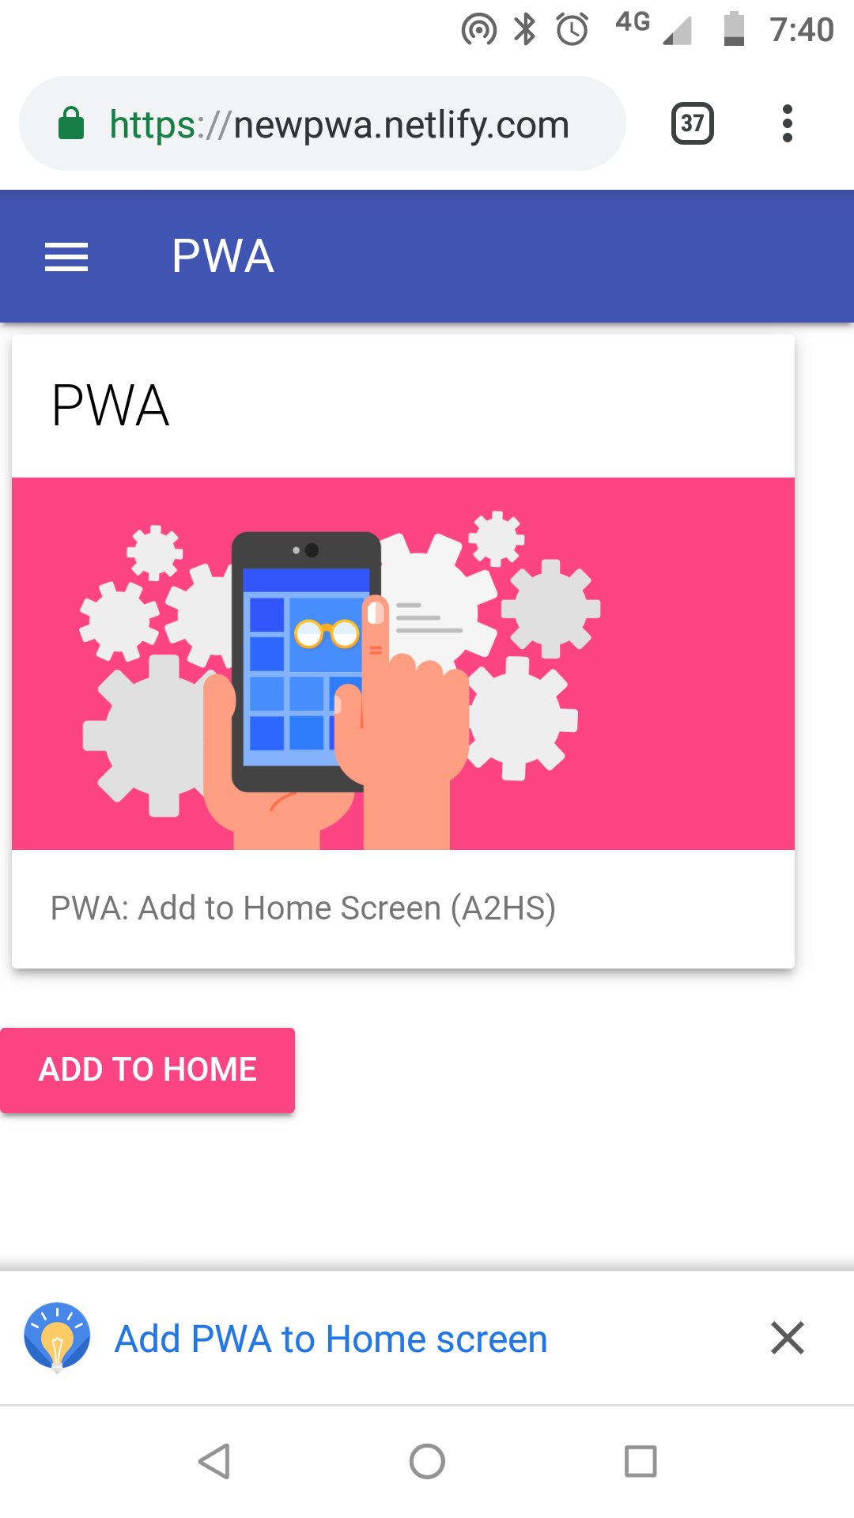
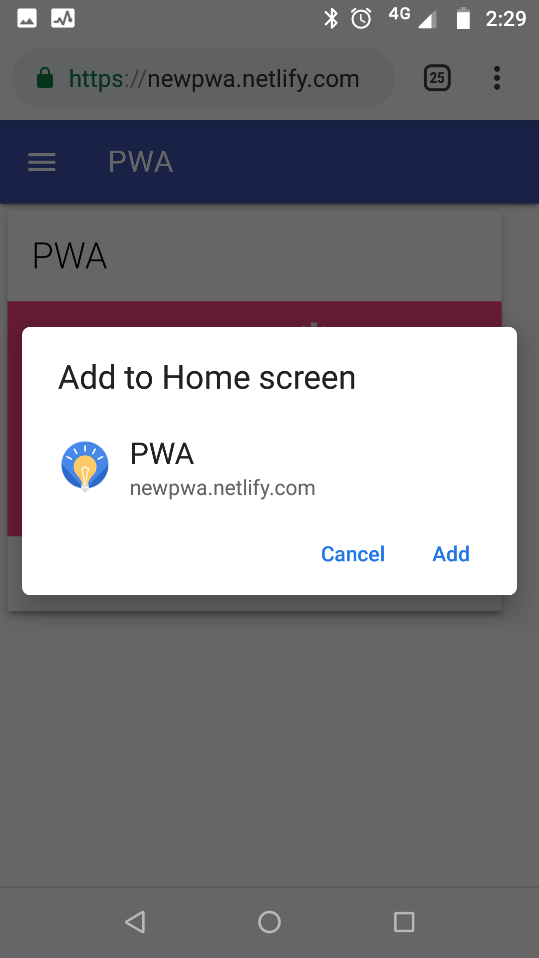
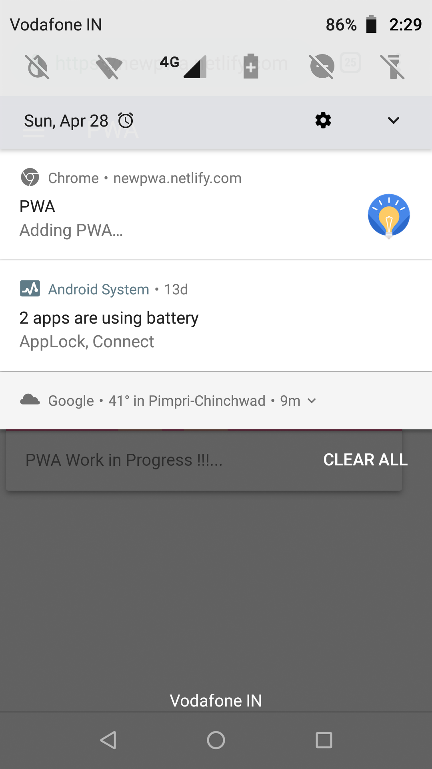
https://newpwa.netlify.com

Slide 38
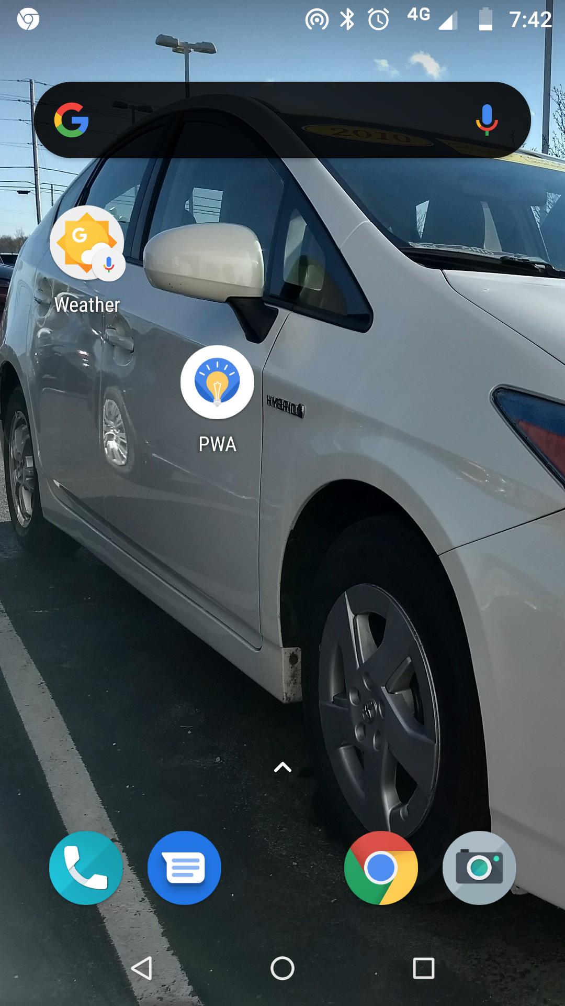
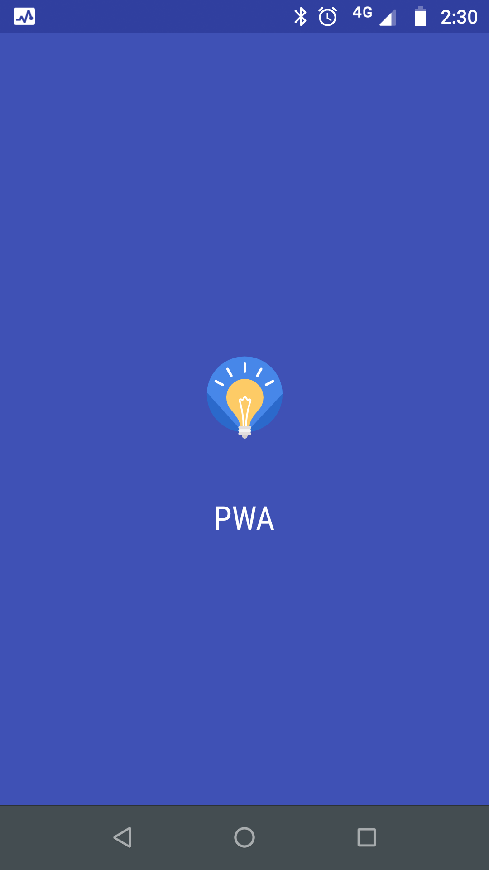
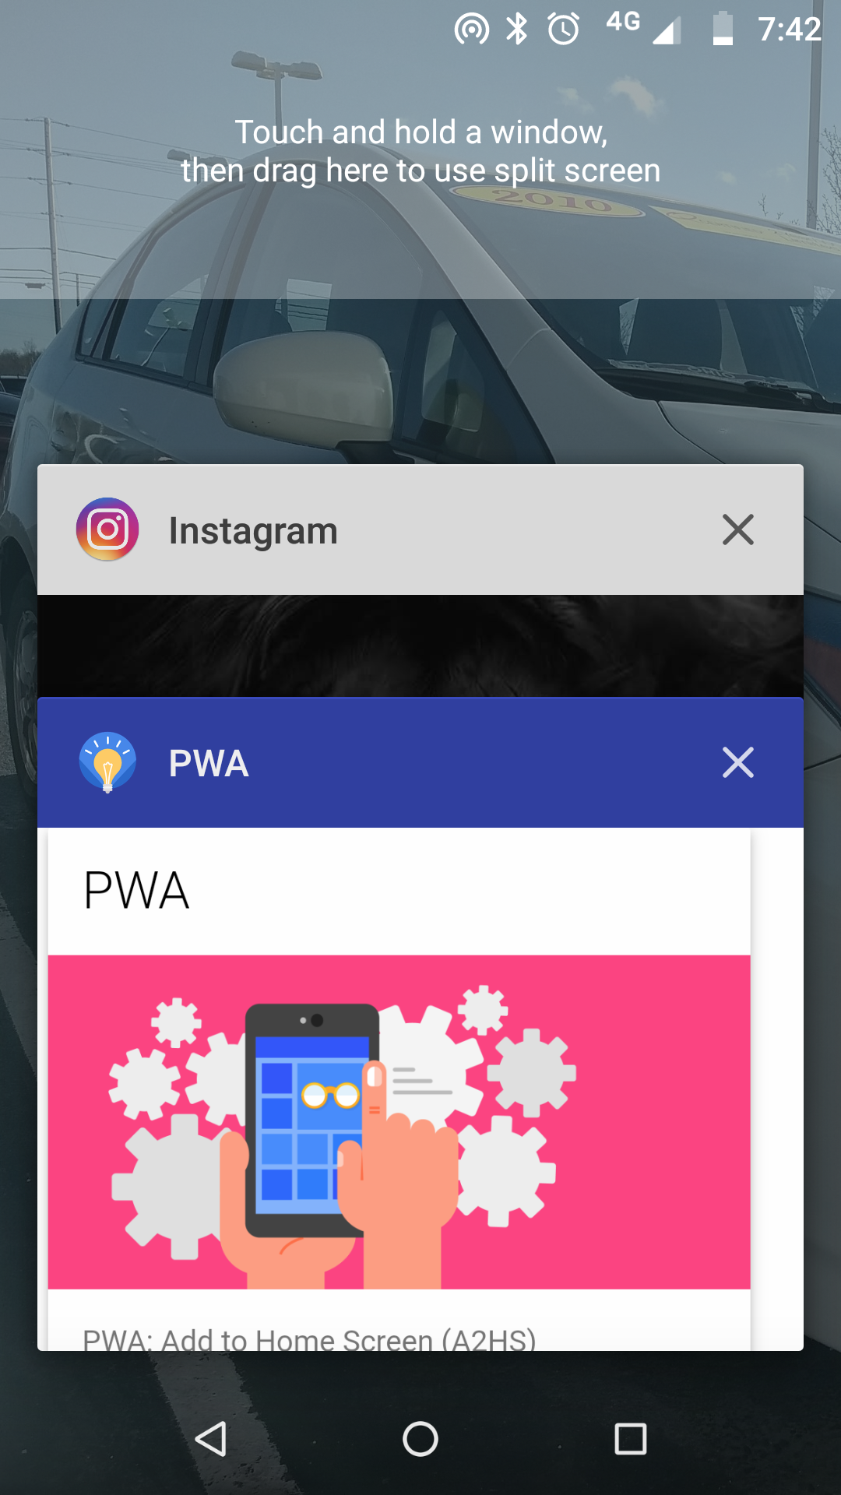
https://newpwa.netlify.com

Slide 39

App Shell
Feels App Like
Engaging

Slide 40
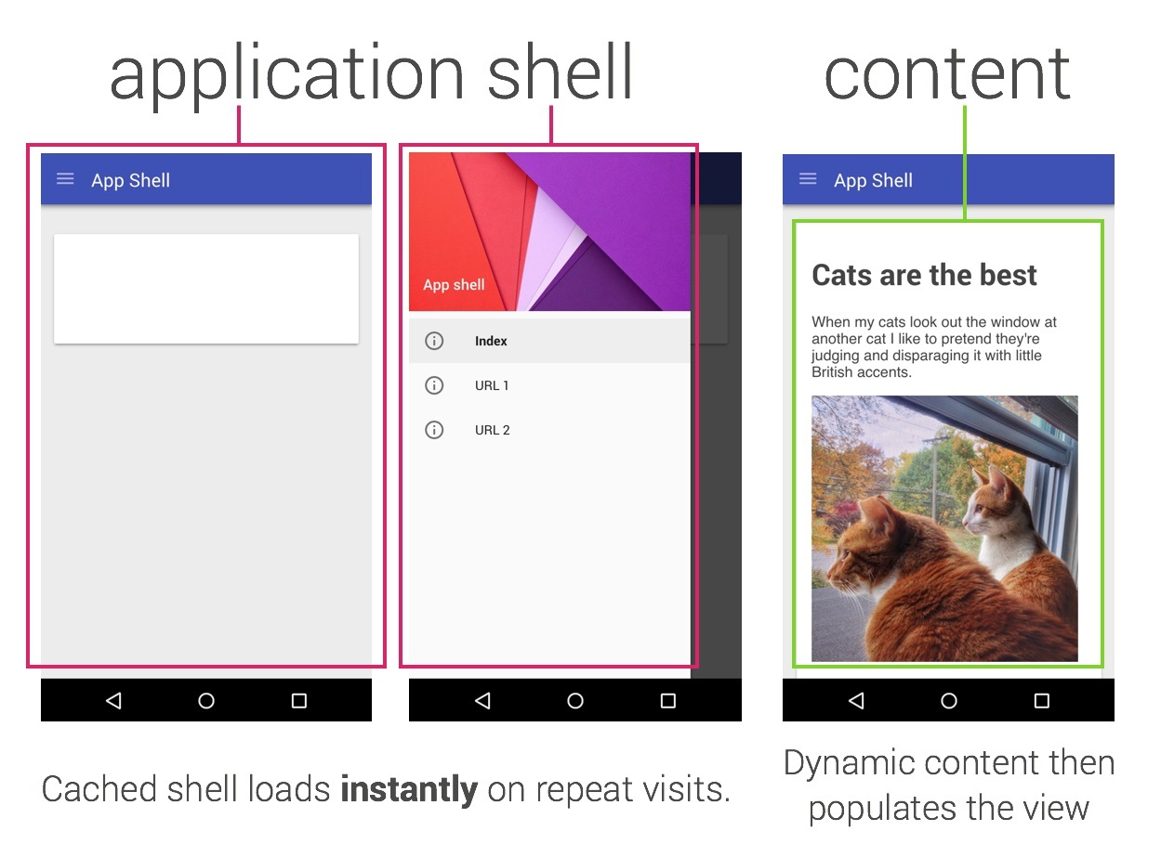
App Shell

Slide 41
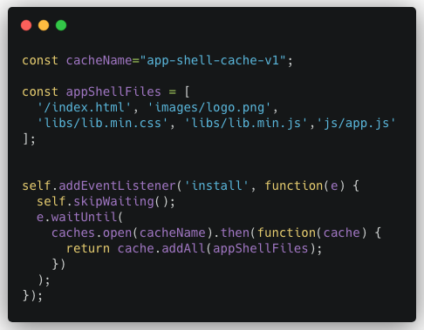
App Shell

Slide 42

Service Worker
Enables Offline Support
Offers Caching Capabilities

Slide 43
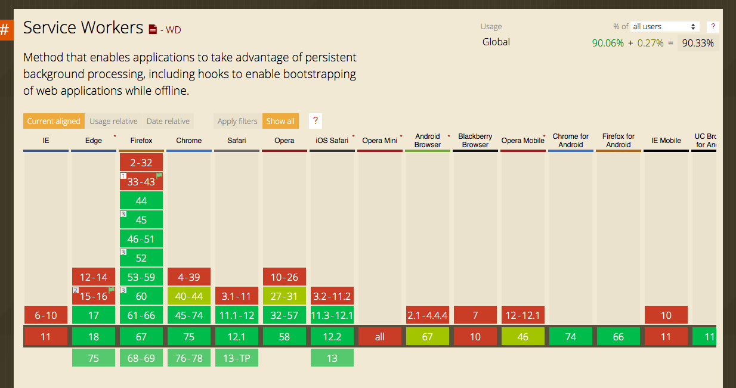
Support

Slide 44
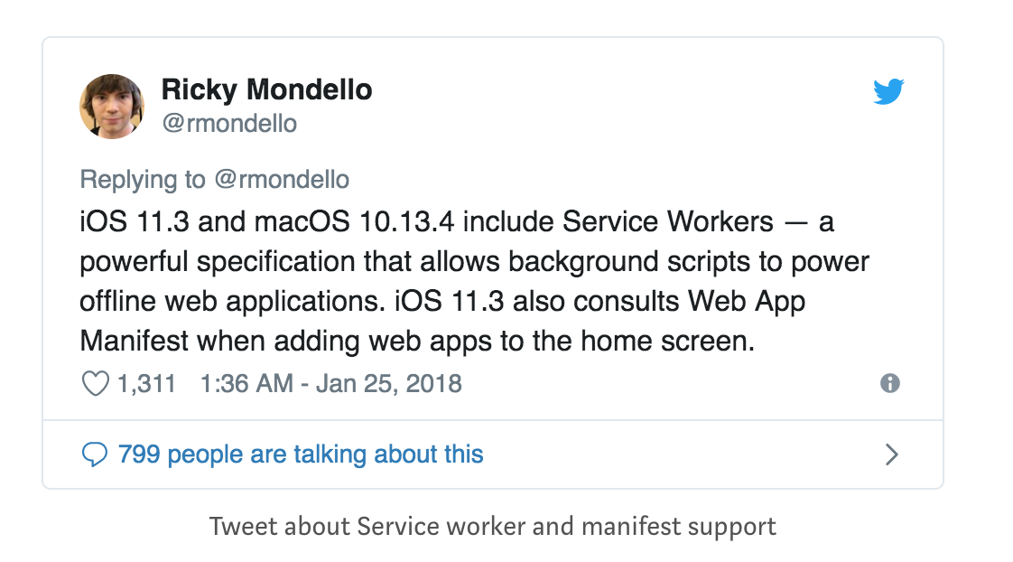
iOS Support

Slide 45
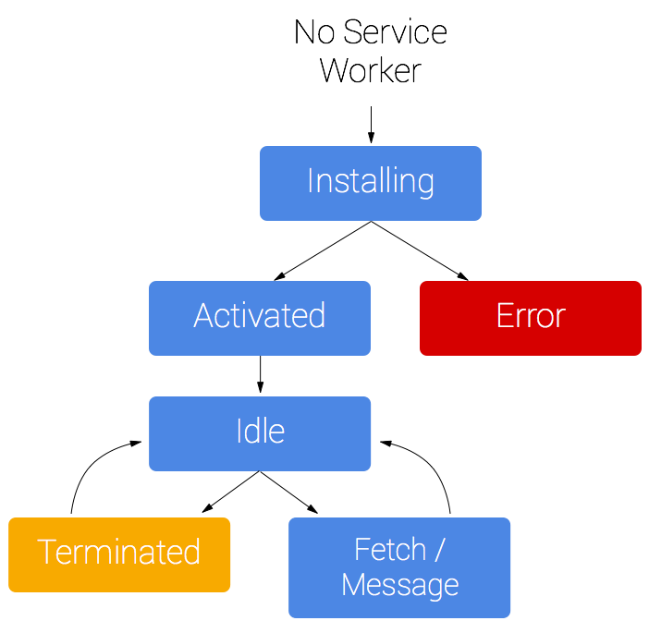
LifeCycle
https://developers.google.com/web/fundamentals/primers/service-workers/

Slide 46
Register
Registering service worker

Slide 47
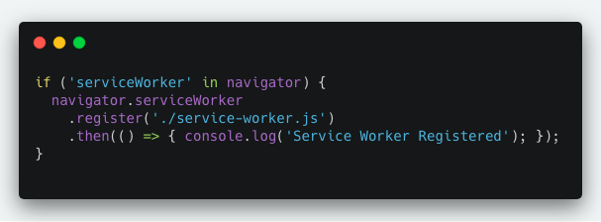
Register
app.js

Slide 48
Install
Ideal for caching static assets...
[ js, css, Images, fonts, templates ]

Slide 49
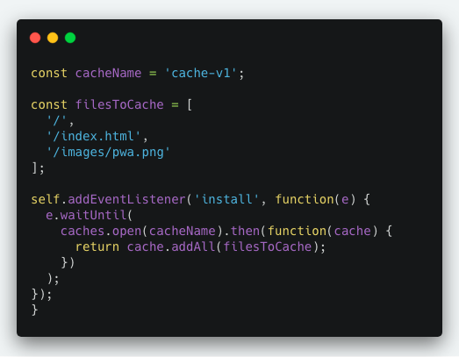
Install
sw.js

Slide 50
Activate
Clean up...
delete previous cache

Slide 51
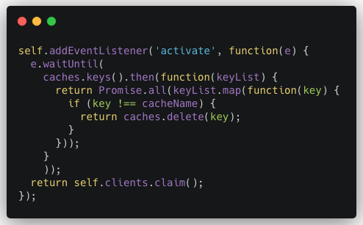
Activate

Slide 52
Fetch
For Webservice calls

Slide 53
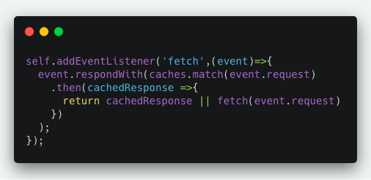
Fetch

Slide 54
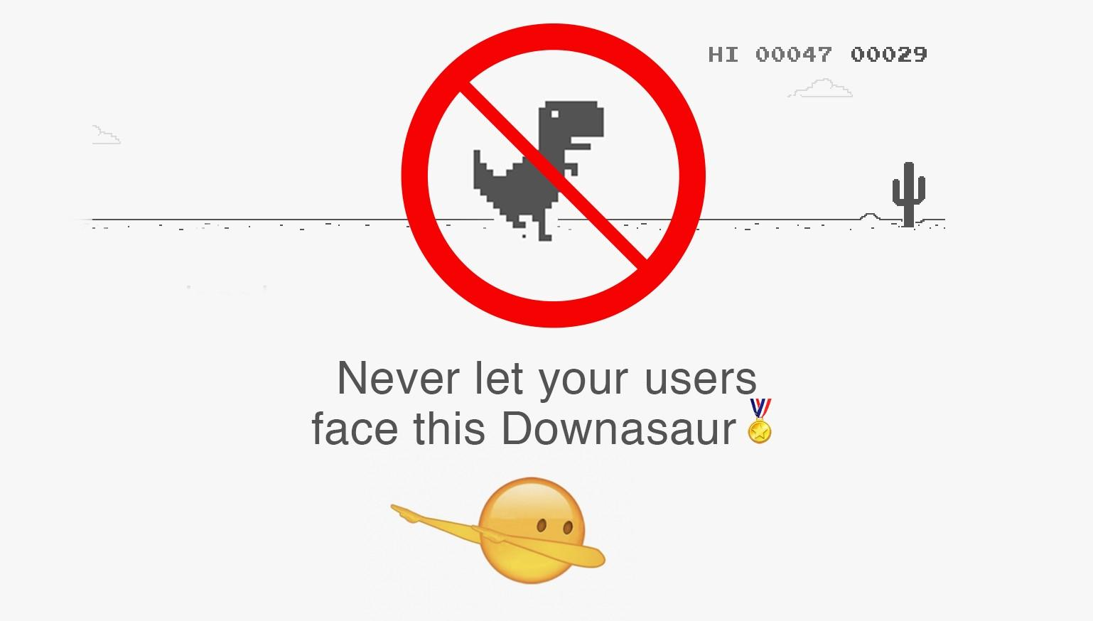

Slide 55
Caching Strategies

Slide 56
Common Caching Strategies
Cache Only
Network Only
Cache First
Network First
Cache Then Network
Stale While Revalidate

Slide 57
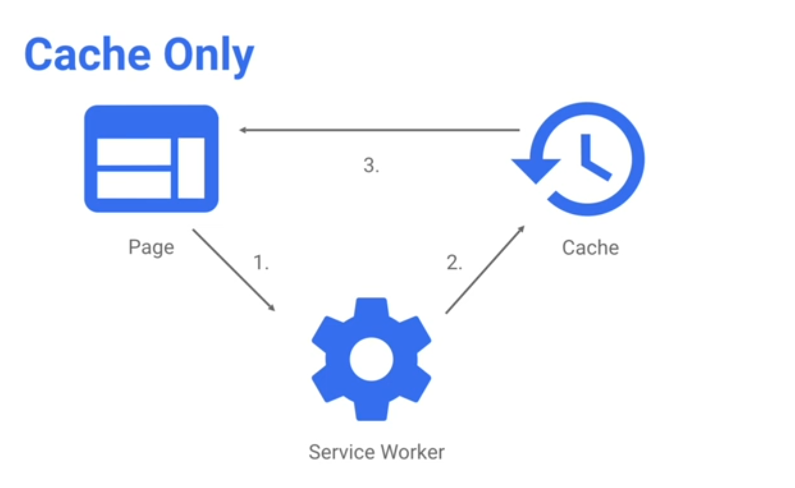

Slide 58
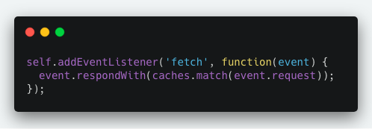
Cache Only

Slide 59
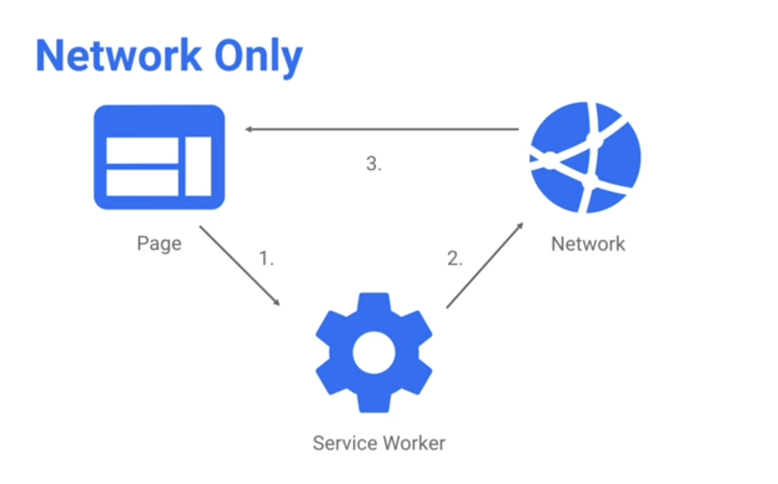

Slide 60
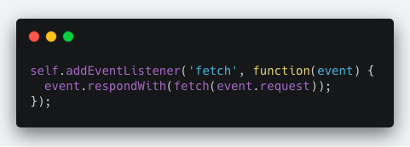
Network Only

Slide 61
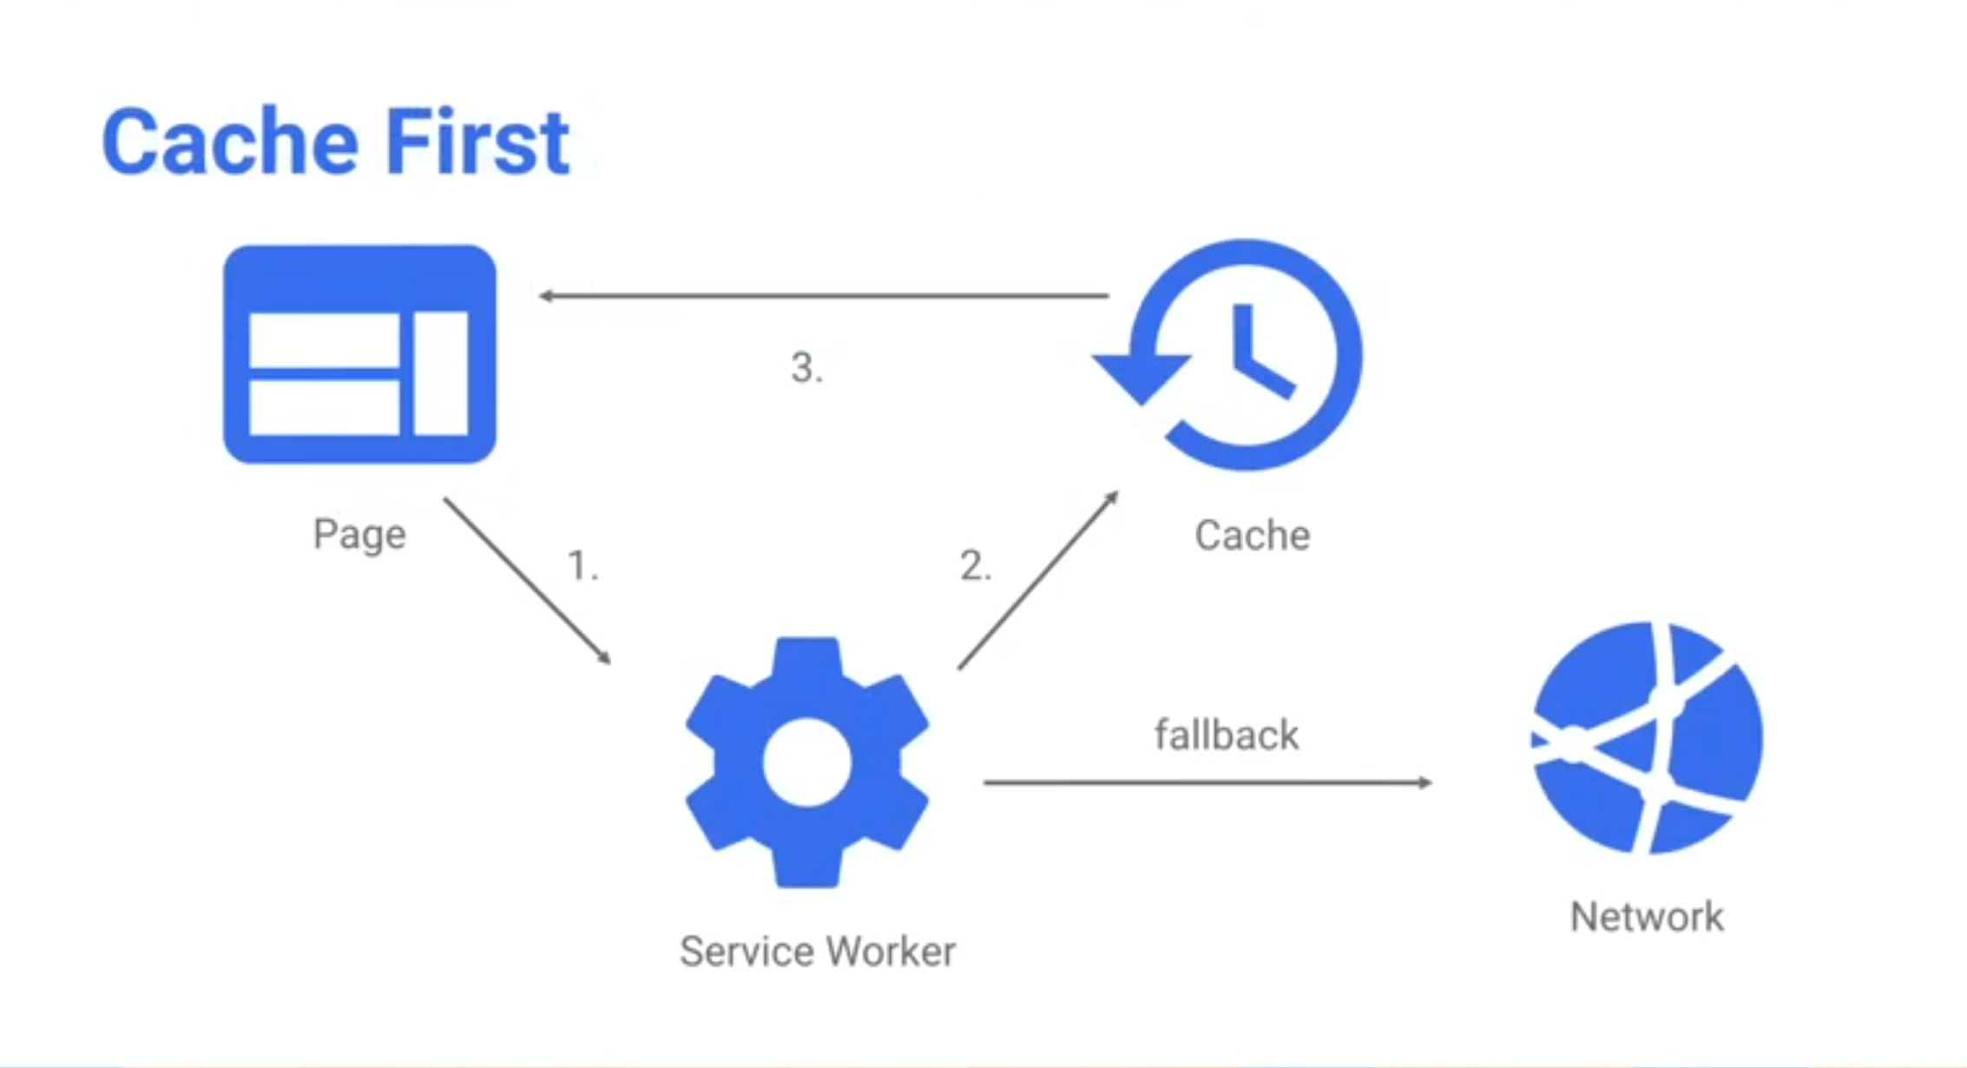

Slide 62
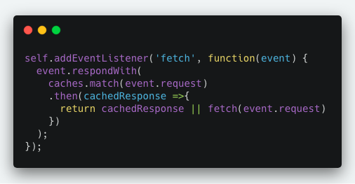
Cache First

Slide 63
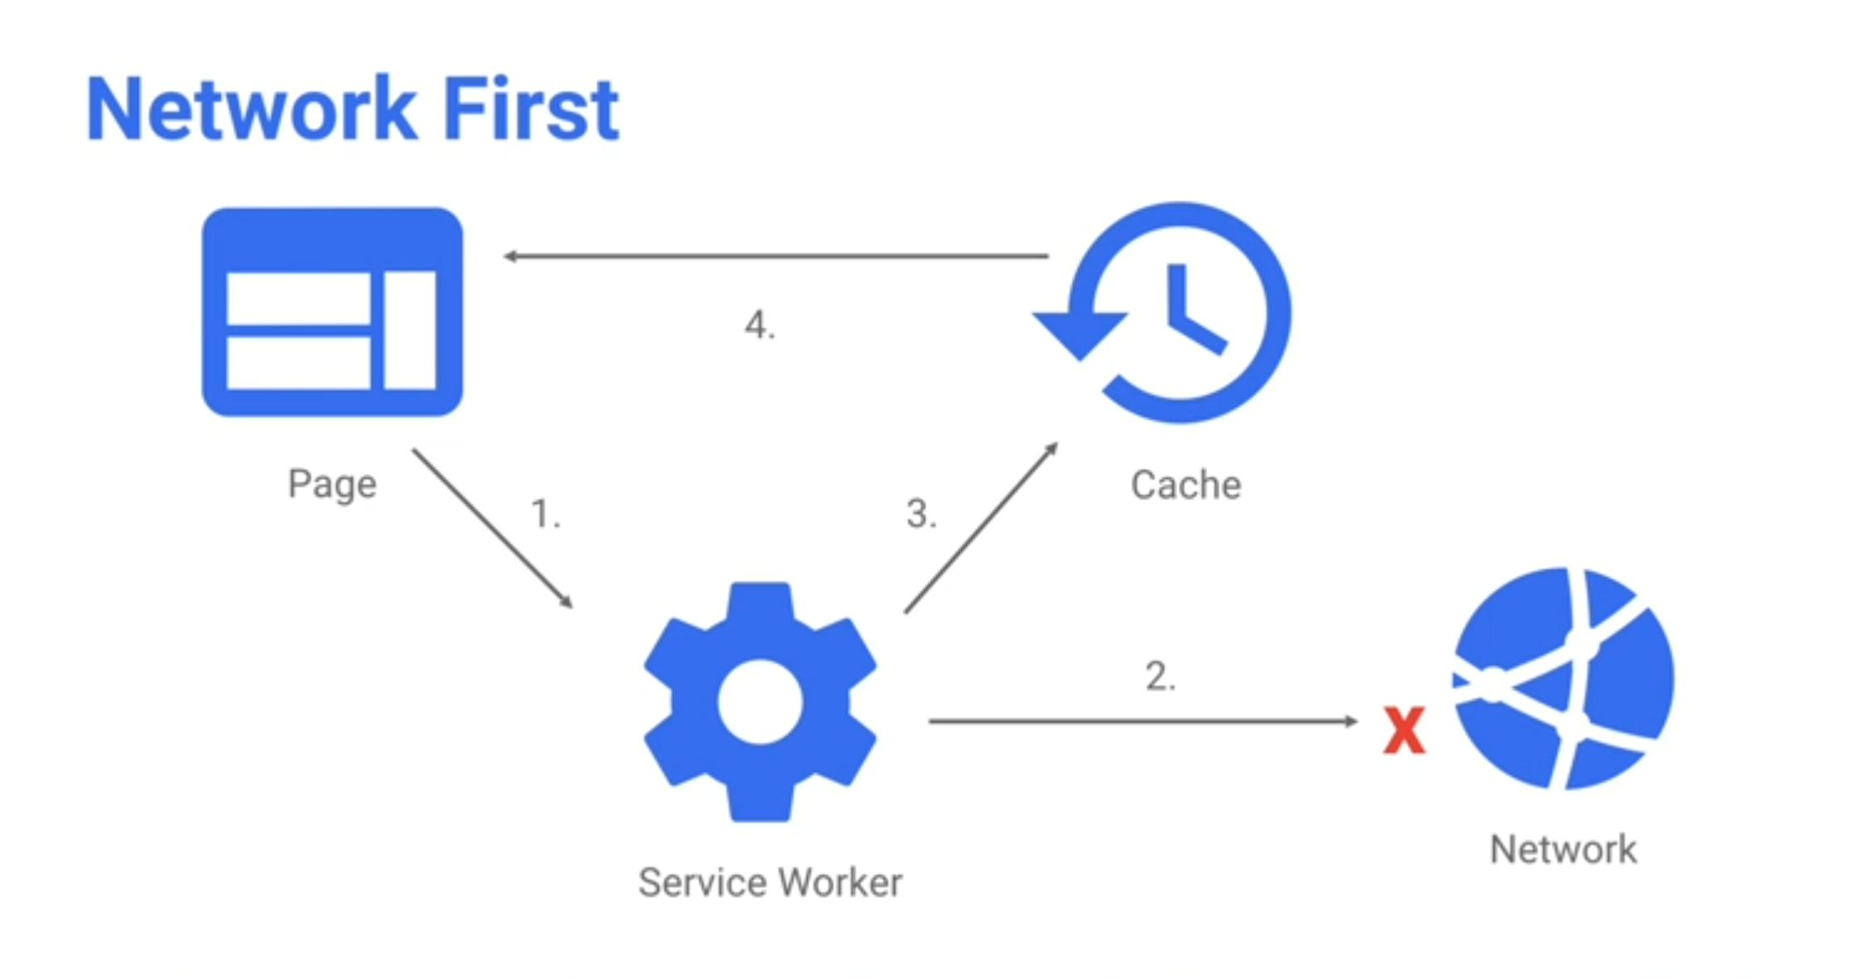

Slide 64
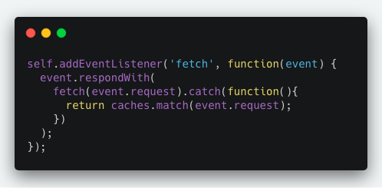
Network First then Cache

Slide 65
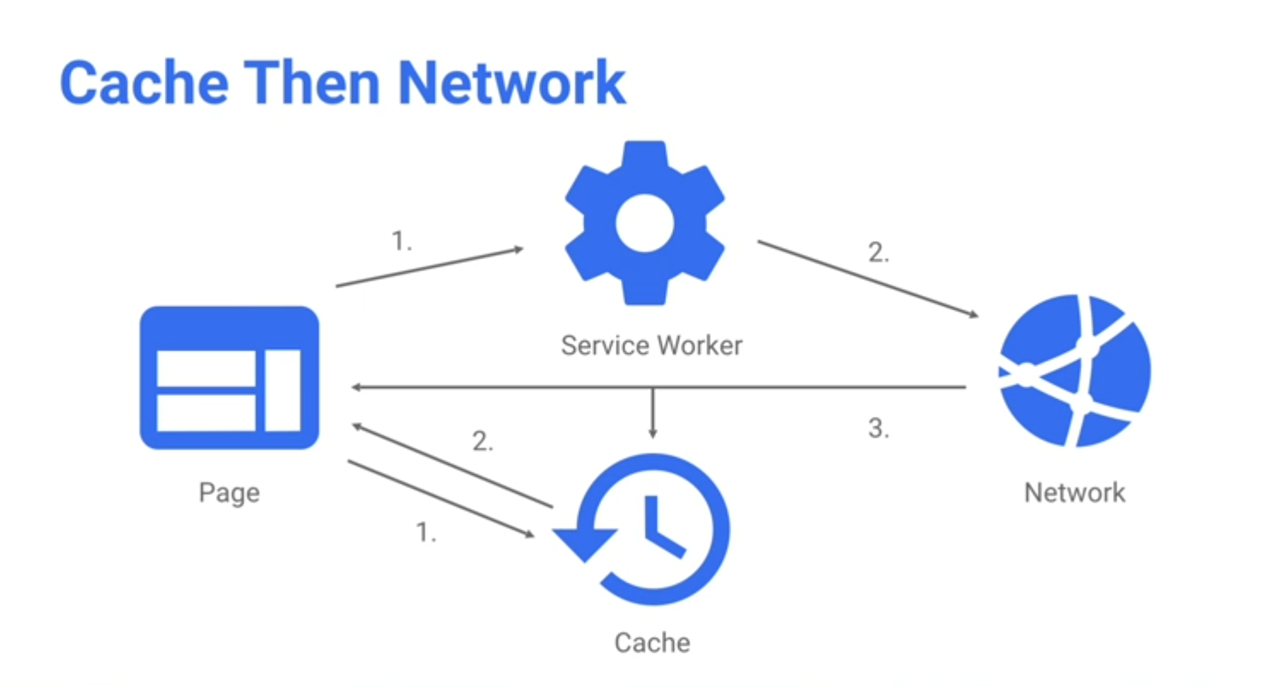

Slide 66
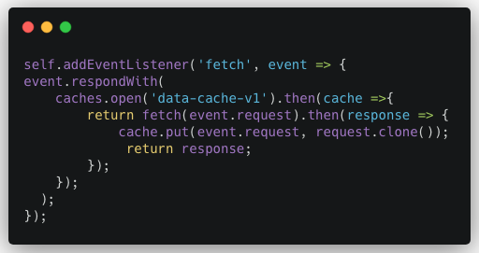
Cache Then Network

Slide 67
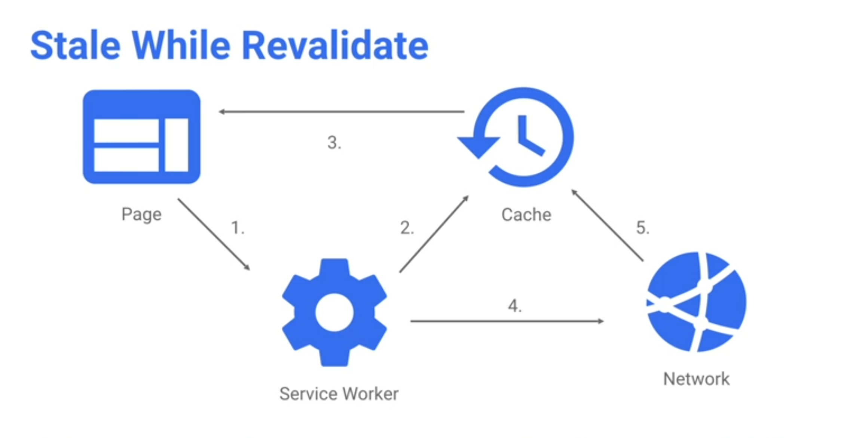

Slide 68
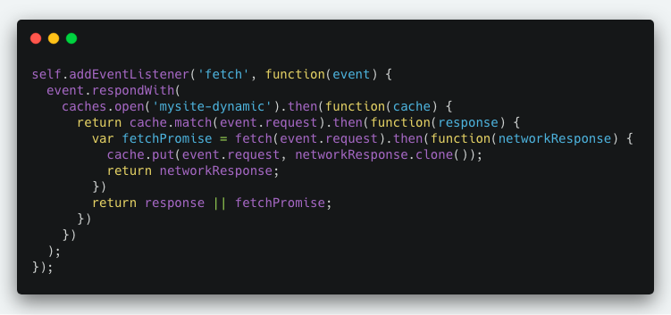
Stale While Revalidate

Slide 69
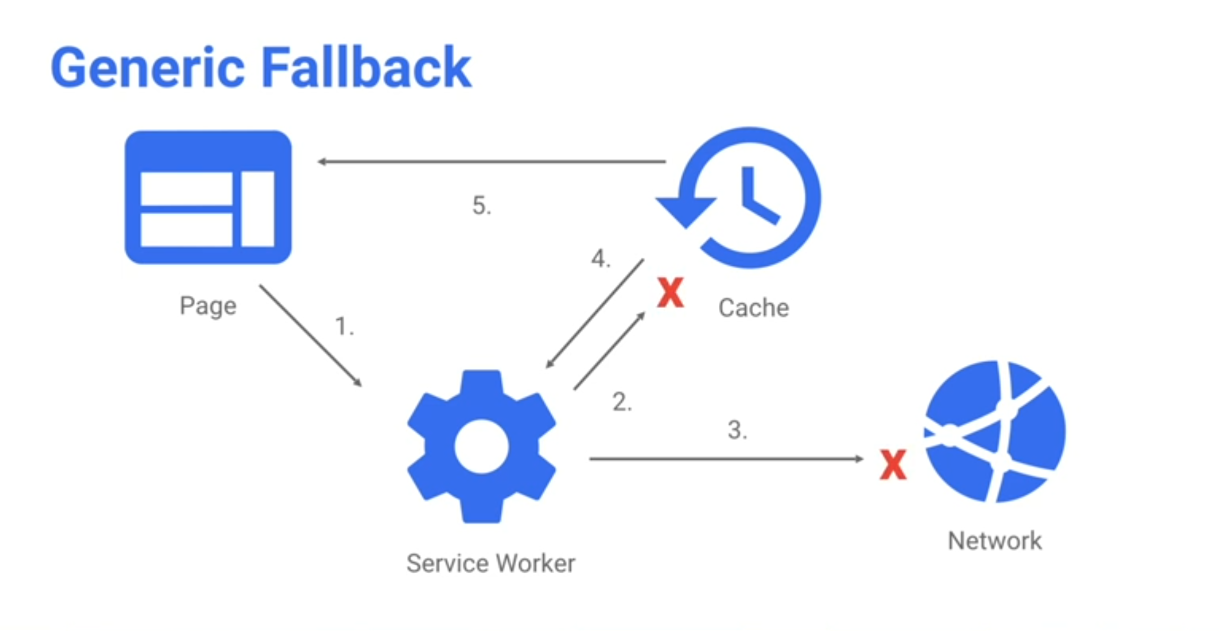

Slide 70
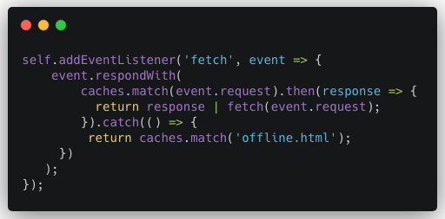
Generic Fallback

Slide 71


Slide 72


Slide 73
Workbox makes it easy to cache assets and take full advantage of features used to build Progressive Web Apps.

Slide 74
Why Workbox?
Workbox is a library that removes the boilerplate every developer writes when working with service workers.
Precaching
Runtime caching
Strategies
Request routing
Background sync
Helpful debugging

Slide 75
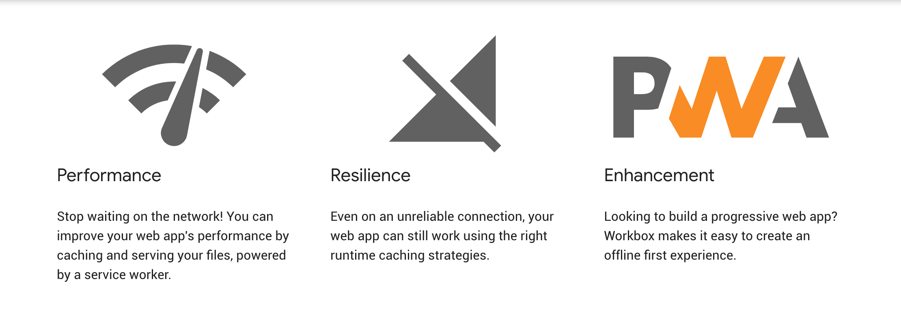

Slide 76
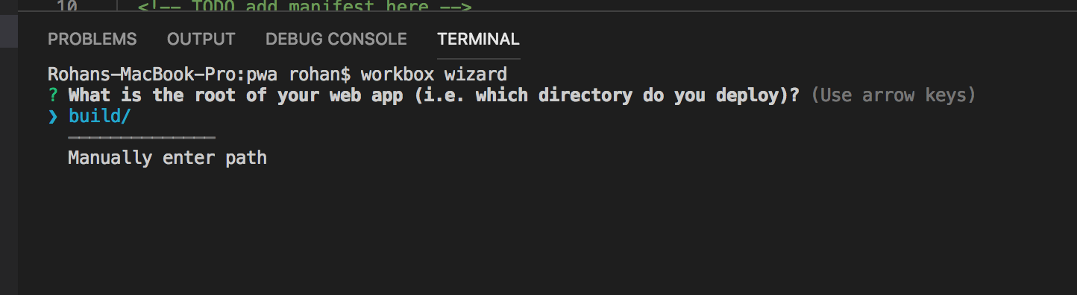
Workbox
Install : npm install workbox-cli --global

Slide 77
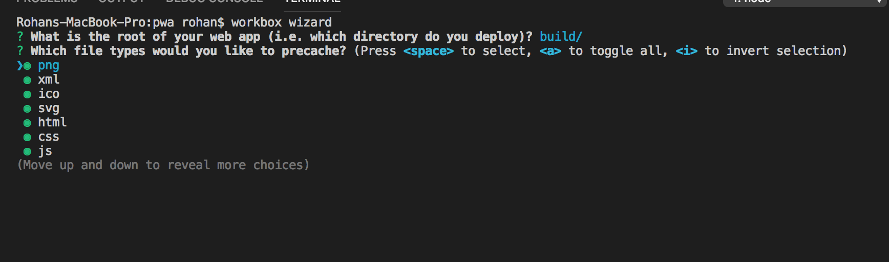

Slide 78


Slide 79


Slide 80


Slide 81


Slide 82
PWA Patterns….

Slide 83
PRPL Pattern
Pattern for structuring & serving PWAs with emphasis on Performance of app delivery and launch.
Push critical resources for initial route
Render initial route
Pre-cache remaining routes
Lazy-Load and create remaining routes on demand

Slide 84
PRPL optimises….
Minimum time-to-interactive
During First use (regardless of entry point)
Especially on real world devices
Maximum caching efficiency, especially over time as updates are released
Simplicity to develop and deploy

Slide 85
PWA on Desktop

Slide 86


Slide 87


Slide 88


Slide 89
Notifications

Slide 90

Reengage Users
Notification API
Push API

Slide 91


Notification Permission

Slide 92

Notify User with Options

Slide 93
Demo

Slide 94


https://pwanotify.netlify.com

Slide 95
Debuging Tools

Slide 96


Slide 97
Thank You...
@rohan12patil

